Slide 1
Final Project Part i
by Aisha Flores

Slide 2
Project Idea
Using NACCHO 2013 National Profile of Local Health Departments
Idea 1:
Problem: Determine the association between technology capacity and accreditation readiness among US local health departments. Using the cross-sectional secondary data from the NACCHO 2013 National profile of Local health departments and accreditation readiness criteria as specified by PHAB (Public Health Accreditation Board). PHAB prerequisites are completion of a community health assessment (CHA), community health improvement plan(CHIP), and agency-wide strategic plan (SP) within the past five years.
We will test if reported technology capacity such as IT area (EHR, HIE, eRegistry, Disease Reporting system, eLab Reporting systems), communication channels (social media, mobile, email marketing usage), and mobile technology tools (smartphones, tables, other) are associated with accreditation readiness (i.e. have completed the PHAB prerequisites.
Possible Idea 2:
Determine what other factors may be associated with accreditation readiness
Hypothesis
LHDs are less likely to meet PHAB accreditation readiness criteria when there is a lower level of technology capacity within a LHD.
Notes:
The purpose of the 2013 National Profile of Local Health Departments
(Profile) study was to develop a comprehensive and accurate description of
LHD infrastructure and practice

Slide 3
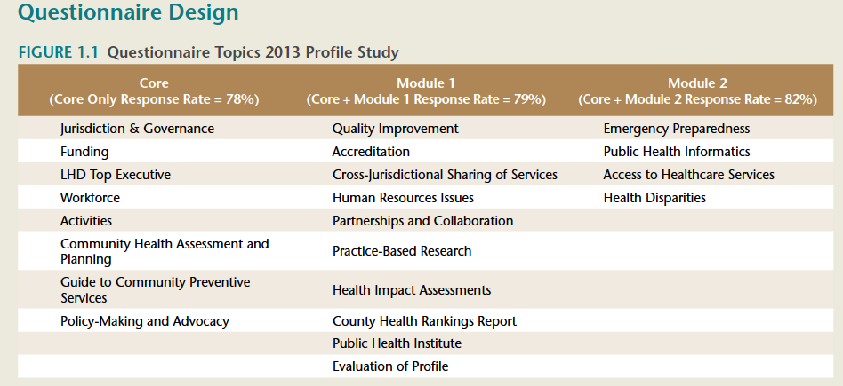

Slide 4
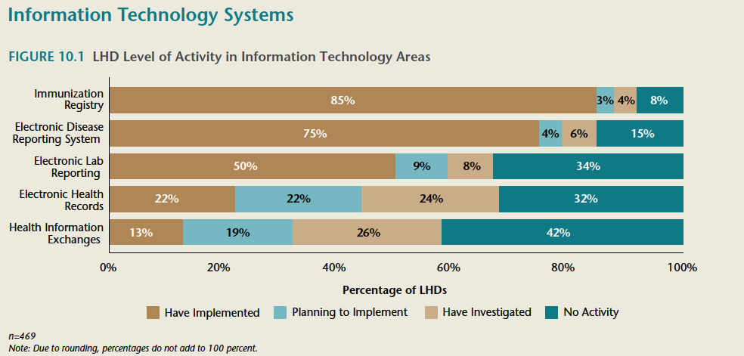

Slide 5
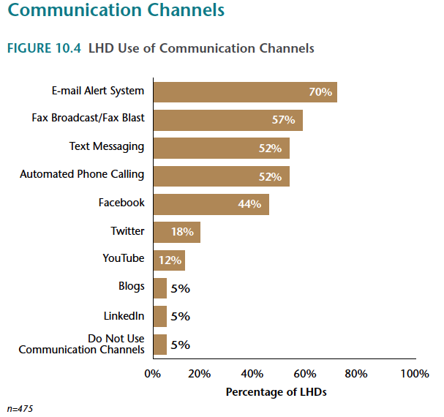

Slide 6
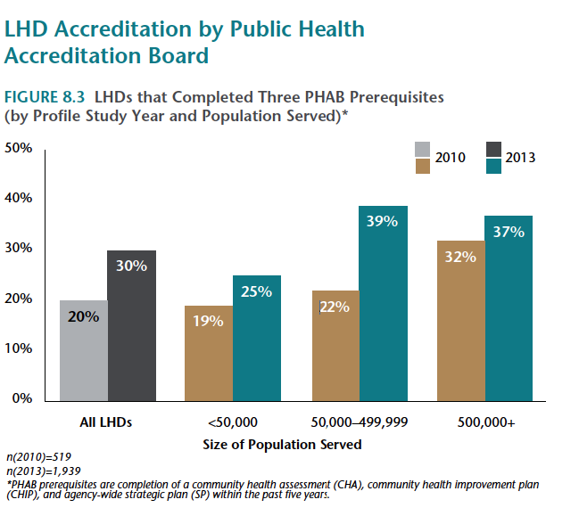

Slide 7
The Data
National Survey data from 2013, self-reported by LHDs
Analysis
Basic descriptive statistics on technology and accreditation related variables
Correlation matrix
Challenges
Multiple variables to analyze
Missing data
Notes:
For the 2013
Profile study, a total of 2,532 LHDs were included in the study population

